Slide 1


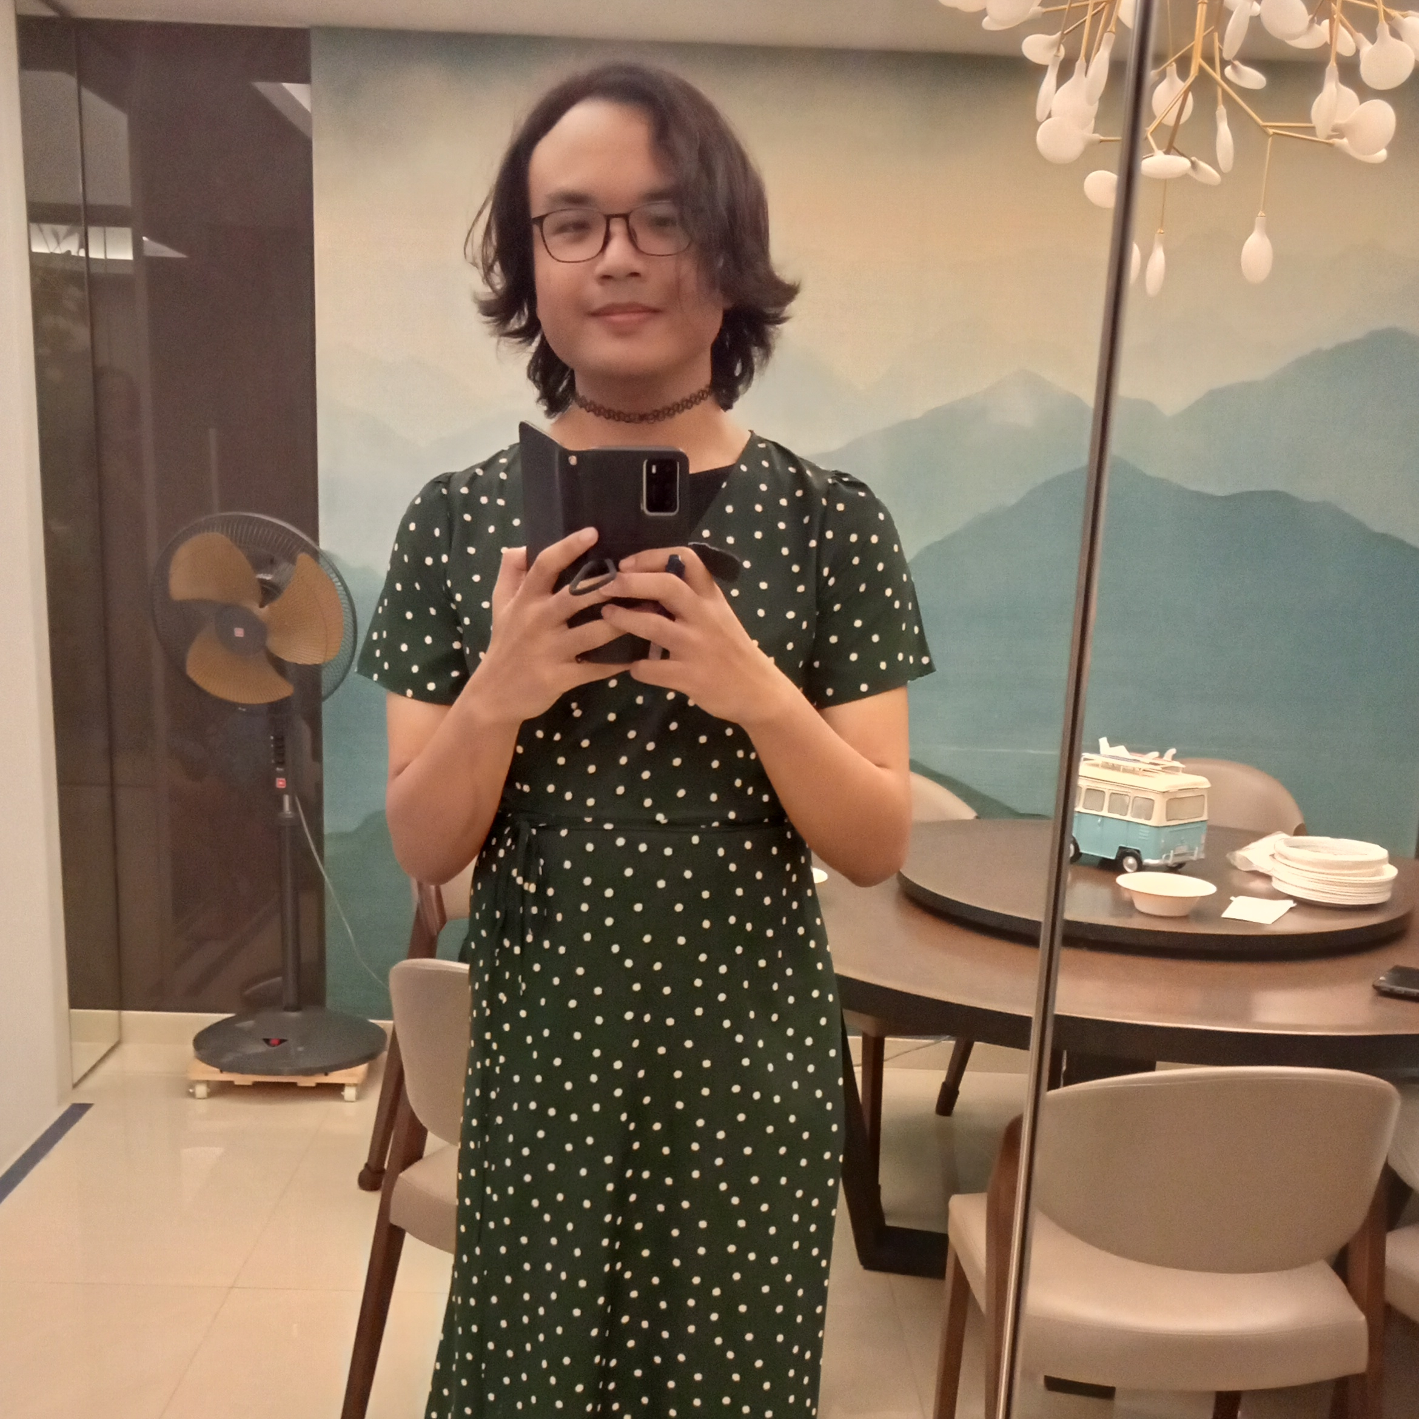
TOMOWORK GOAL SETTING WORKSHEET
NAME
ARIF HAMED
INSTITUTE
NANYANG POLY
GOAL START DATE
20 MARCH 2023
GOAL COMPLETION DATE
1 JUNE 2023
MY CAREER GOAL IN 6 YEARS
WORK
Full-time in any big tech firm that involves IT research
LEARNING
First get internship from a big tech firm, like IBM or NCS, then get a sponsorship from them for uni, get bachelor’s in IT
ACTIVITIES
Probably arts, like origami, or create educational videos about technology, or produce my own music.
5 THINGS I WANT TO ACHIEVE FROM TAP (Please include more than 1 soft skills)
ACTION THAT WILL HELP ME TO REACH MY GOAL
REVIEW
(REVIEW BY 31 MAY MORNING)
1 | Communication
2 | Problem-Solving
3 | Understanding my strengths (beyond the hard skills)
4 | Better understand work in the community
5 | ENHANCE CV
1 | My willingness & participation
2 | PLANNING and making steps for work
3 | Put in my effort 100%
4 | Consider the present before the future, and do what is in my power first
5 | Pick up beneficial habits, such as keeping in track with the financial market
1
2
3
4
5
COMMENTS FROM FACILITATORS

